Slide 1
Walmart Store Weekly Sales Forecasting
By-:
Abhinav Athankar-1705003
Snehashis Hansda-1705177
Ruchit Bansal-1705162
Vishwasheel Dwivedi-1705285

Slide 2
01
Introduction
02
Problem statement and Project Planning
03
Random Forest Regressor
CONTENTS
04
Implementation
05
Result and Discussion
06
Conclusion

Slide 3
Introduction
PART 01
During the ideation process, we realized that our minds are inclined towards business and analytics. The challenge of modelling retail data is the need to make decision based on limited history. Different festive seasons comes every year, so does the chance to see how strategic decision impacts the business.

Slide 4

Note-:
The aim of this project is to enable category managers of Wamart to check the weekly sales of the departments. Analys is includes the effect of markdowns on the sales and the extent of effect on the sales by fuel prices, temperature, unemployment, CPI etc. has been analyzed using simple random forest regression models. The user interface for this project is user friendly .

Slide 5
Introduction
We live in a competitive world which thrives to win. Data-driven decision making is reliable
strategy for business decision. Forecasting is used across wide array of domain to make
informed estimates that are predictive in determining the direction of future trends. Sales
forecasting uses historical data to identify trends in order to make data-driven decision which
could lead to huge Hypermarkets are also very competitive in nature. They run promotional markdown event throughout the year. These events attract customers in huge number. When holidays like Christmas and Thanksgiving approaches, sales are sky rocketing. This project aims to predict the weekly sales of stores using the dataset of Walmart, which contains historical markdown data of 45 stores, located in different regions. This project will build and deploy Machine Learning algorithm namely, Random Forest Regressor to predict the weekly sales of the stores.In addition, this project will use the most common visualization techniques used in the field of data science like heatmap and bar chart, to name a few.

Slide 6

Problem Statement
Walmart runs major promotional markdown events every year. Walmart has provided historical data for 45 stores located in different regions. These markdown events include
prominent holidays namely, Thanksgiving and Christmas. These markdowns are known to
affect sales, but it of utmost importance to predict which department of the stores are affected
and to what extent.

Slide 7

Project Planning
We have merged the data files generated from the past to our convinience for analyzing and planned accordingly.

Slide 8
Methodology used to analyse problem
1. Initially analyzed the problem to understand what kind of machine learning problem is this, i.e.
Supervised or Unsupervised.
2. Under Supervised learning, it falls under regression problem which can be easily solved with
Random Forest Regression.
We have used the dataset provided on Kaggle by Walmart for training and testing the model.
Steps involved in training the dataset are as follows:
1.Data pre-processing: Merging store data and features data with train and test.
2.Data exploratory analysis through various visualizations.
3.Treating the missing values.
4.Feature extraction and selection.
5.Training the regression model and checking its efficiency.
6.Hosting the code on GitHub pages.

Slide 9
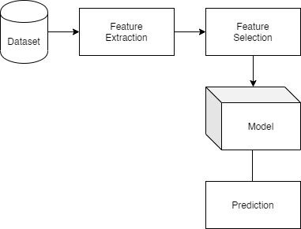
System Architecture and Data set
The dataset used for this project of predicting the sales of Walmart, world’s largest brick and mortar retailer.It incorporates data of 45 Walmart stores and its departments. The dataset has been derived from Kaggle.The files used in this project for analysis are features.csv, stores.csv, test.csv and train.csv
features.csv: This file involves store and department details and various additional details about the activities occurred in that region.
•Store: Each store has a unique store number for identification purpose.
•Date: Signifies the date.
•Temperature: Signifies the avg temperature recorded.
•Fuel_Price: Signifies the cost of the fuel.
•MarkDown1-5: This includes the data about the promotional markdowns which Walmart is hosting.
•CPI: Signifies the customer price index.
•Unemployment: Signifies the rate of unemployment.

Slide 10
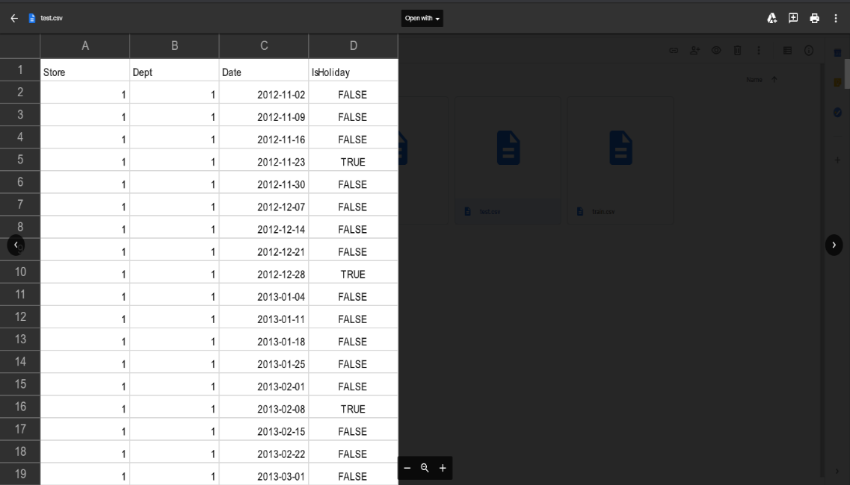
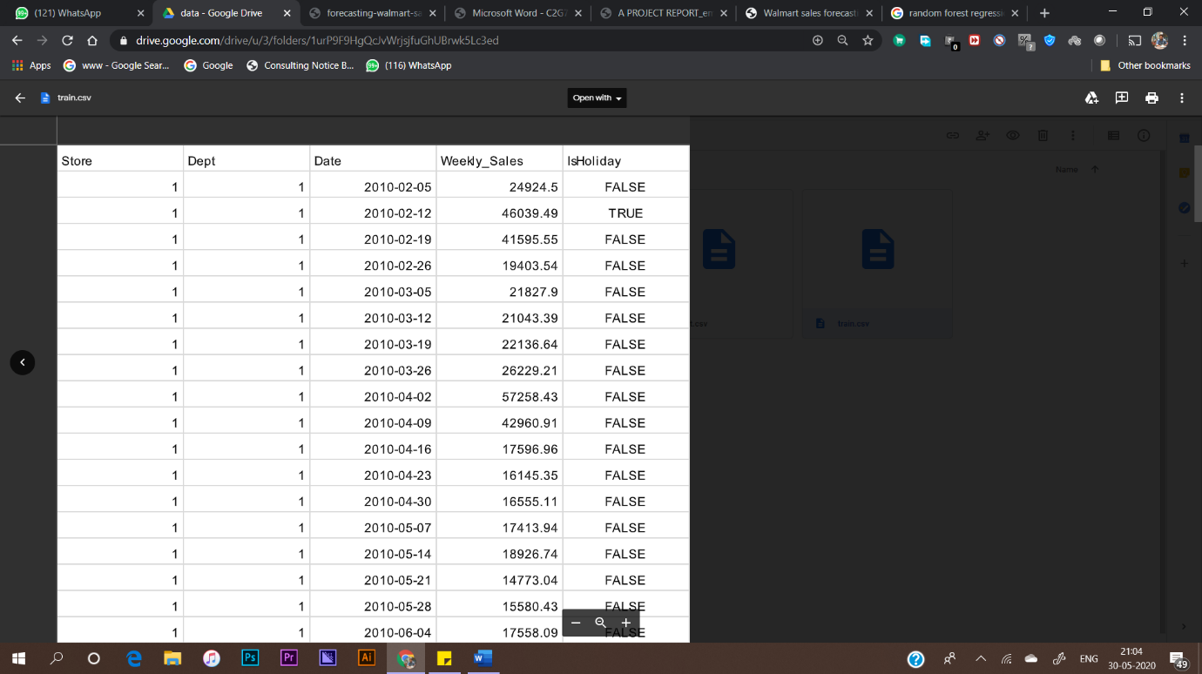
Sample Datas
train.csv: Here we will find the past training data which include the following fields.
•Store: Indicates the store number.
•Department: Indicates the department number.
•Date: This field indicates the week in which the event held.
•Weekly_Sales: This field denotes the sales done in a week for that given department.
test.csv: This file includes details about the stores and departments. It also denotes the date indicating the week and IsHoliday which indicates if that week is a special holiday week.

Slide 11
Random Forest Regressor
The Random Forest Regression method is best used when we want to increase our accuracy by increasing the randomness in the taking the subset of features. The original dataset is converted to bootstrap dataset where a subset of values is inherited in random manner and then a decision tree is constructed. The more the trees the more random it becomes by Random Forest regression.

Slide 12
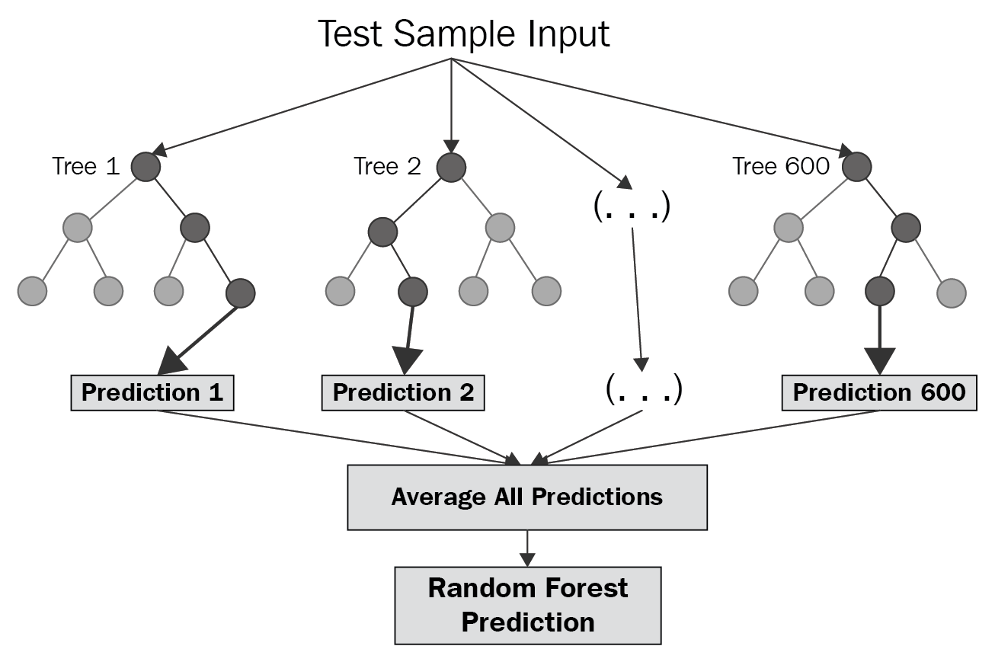
The data fields used through this architecture are store, date, department, temperature, fuel_price, Is_Holiday, Size, CPI, Unemployment. The algorithm was made into effect by Python’s Random ForestRegressor method in scikit-learn class.

Slide 13
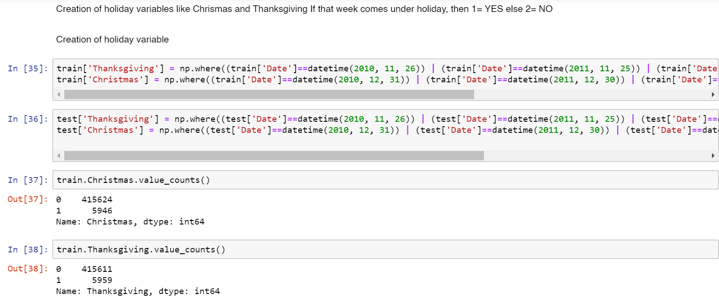
Implementation

Slide 14
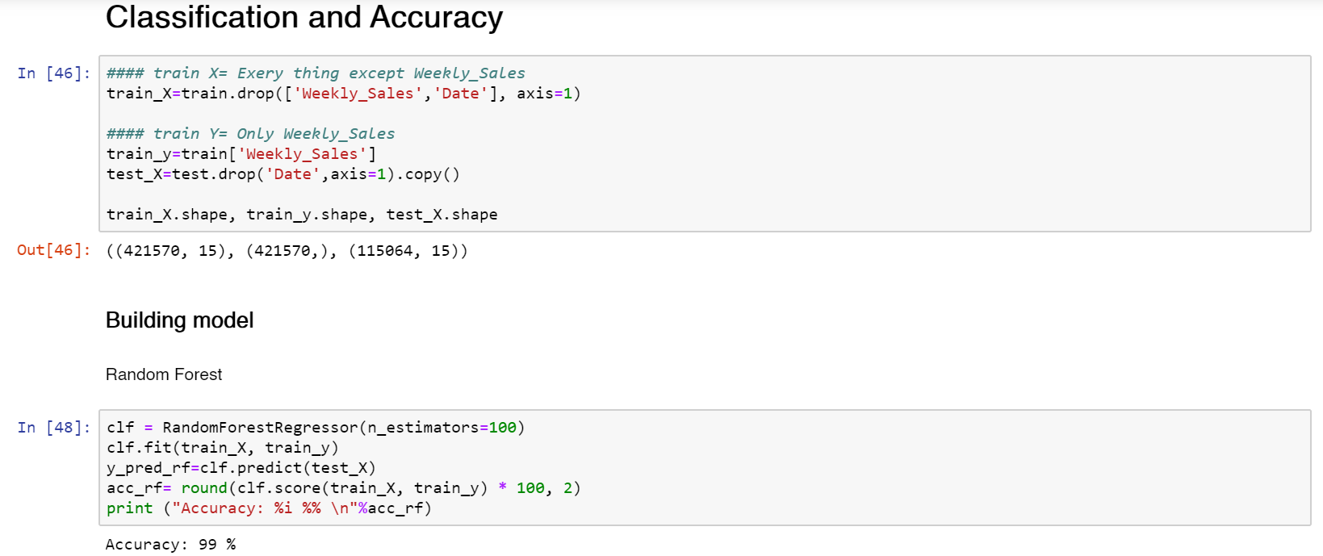
Implementation cont..
Full Implementation: https://snehashis1.github.io/

Slide 15
Result and Discussion
The purpose of this project was to help Walmart to gauge the demand for products. It will help in Inventory Management. It will also help the finance team to accurately budget the coming weeks and months. Proper Inventory Management ensures that there’s no problem related to product shortage.
We plan on implementing similar tactics to provide services to small and medium size for proper inventory management. Further, with regard to current dataset, Walmart can analyze the entire stores data around the US for even more accurate prediction. This can also be used to motivate employees by giving them achievable sales targets.

Slide 16
Conclusion
In conclusion, we find that our regression equation is quite accurate (99% accuracy) in predicting the weekly sales. Walmart can use it to forecast the sales better. Stores try to attract customers by providing special offers, and if the product is well-suited for the customer, then it can make maximum profit.

Slide 17
THANK-YOU

